Slide 1

More about Time Complexity
Instructor: Kuan Cheng

Slide 2
Decision vs Search
So far, we are only concerned with decision problems.
E.g., SAT=given a CNF formula ψ, decide if ψ is satisfiable.
More generally, can consider search problems.
E.g., given a CNF formula ψ, find a satisfying assignment

Slide 3
Decision vs Search
Search is harder than decision
But it is not much harder
We can “reduce” search to decision

Slide 4
Decision vs Search
Theorem:
If ∃ an algorithm A that decides SAT in polynomial time, then ∃ an algorithm B which, on input ψ ∈ SAT, outputs a satisfying assignment in polynomial time, where n is the # of variables.

Slide 6
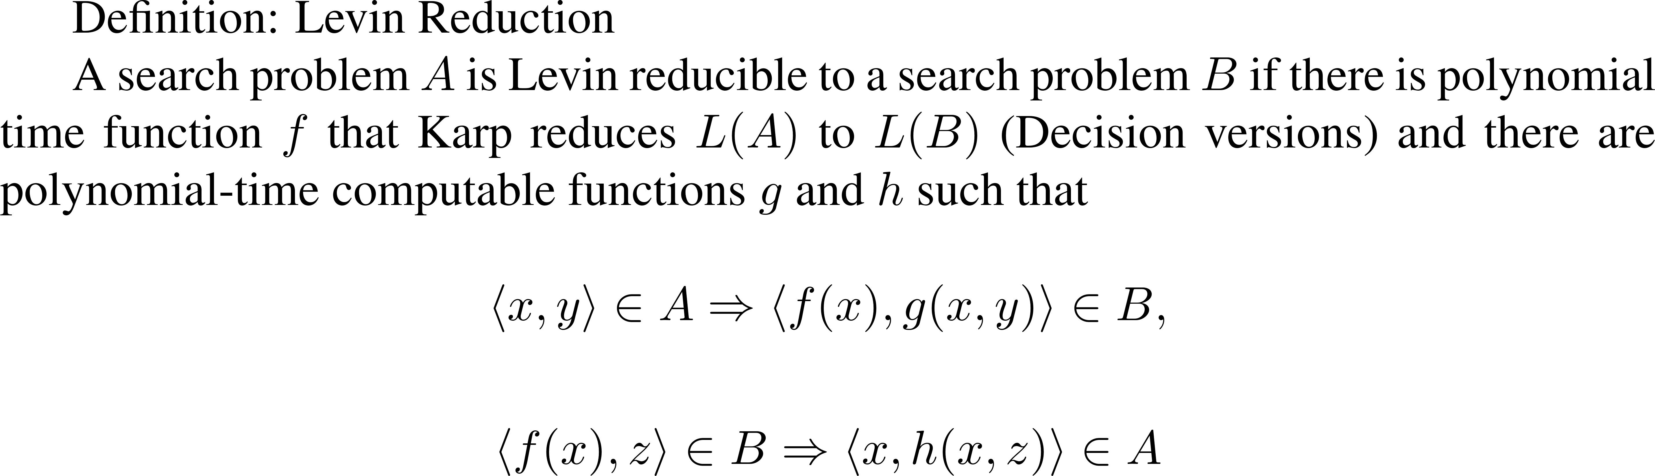
Decision vs Search
Theorem:
If ∃ an algorithm A that decides SAT in polynomial time, then ∃ an algorithm B which, on input ψ ∈ SAT, outputs a satisfying assignment in polynomial time, where n is the # of variables.
Also works for other NP languages. Do the same thing on certificate.
An alternate way, we can first reduce to SAT, and in most cases the reduction also maps certificates to certificates (Levin reduction).

Slide 7
NP-Intermediate Languages

Slide 9
Deal with NP-Completeness
Many practical problems turn out to be NP-complete.
Cannot hope to solve them efficiently unless P=NP.
There are ways to deal with NP-completeness.

Slide 10
Deal with NP-Completeness
NP-completeness is a worst-case analysis.
E.g., SAT, no efficient algorithm can decide if an arbitrarily given CNF ψ is satisfiable.
There may be an efficient algorithm that does this for most ψ.
Average-case analysis: define some probability distribution on the input.

Slide 11
Deal with NP-Completeness
Still study the problem in the worst-case
However, instead of solving the problem exactly, look for an approximation.
E.g., find an independent set with size ≥ 1/2 max independent set.
E.g., find a vertex cover with size ≤ 2 min vertex cover

Slide 12
Deal with NP-Completeness
In the world of approximation, different NP-complete problems behave quite differently.
E.g., find a vertex cover with size ≤ 2 min vertex cover.
Easy to achieve by (e.g.) finding a maximum matching in G (∈P).

Slide 13
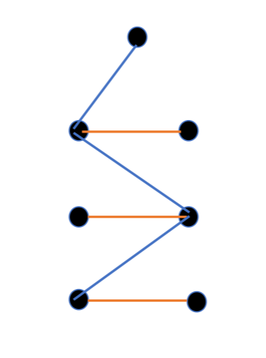
Approximating Vertex Cover
A maximum matching in G implies a vertex cover with size ≤ 2 min vertex cover.
What is the vertex cover?
Take all vertices in the matching.

Slide 14
Approximating Independent Set
Approximating Independent Set is a different story.
Naive 1/n approximation: take any vertex

Slide 15
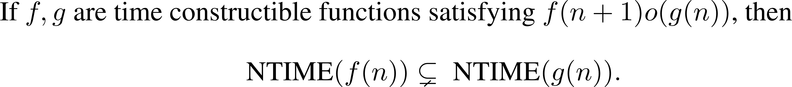
Non-deterministic Time hierarchy

